Slide 1
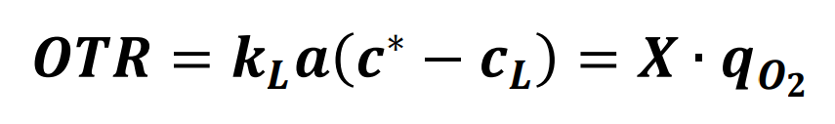
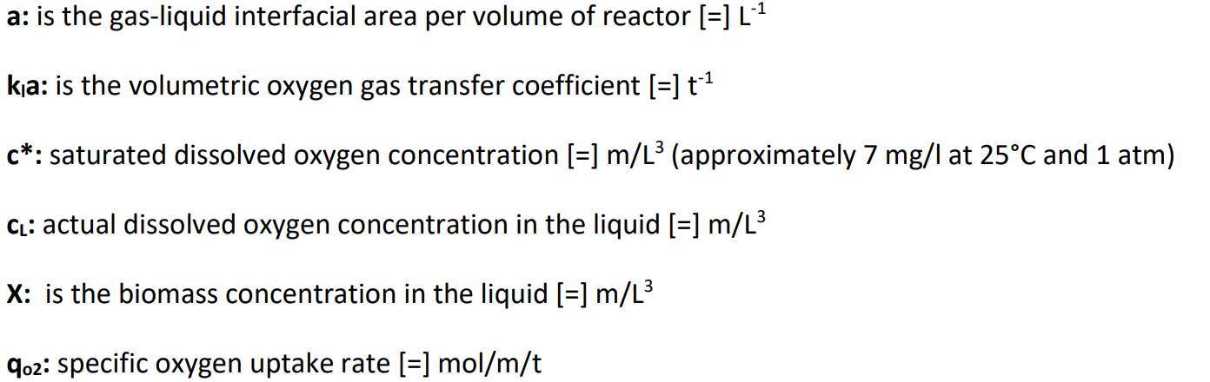
Equations

Slide 2
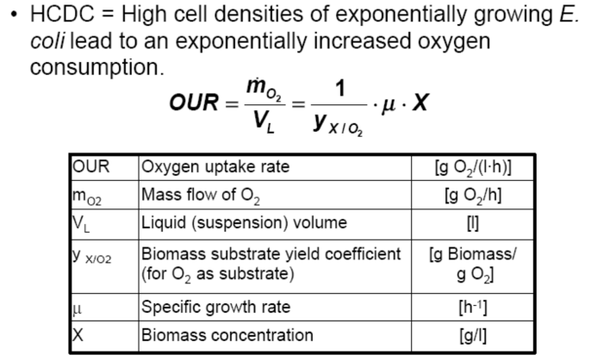
Equations

Slide 3
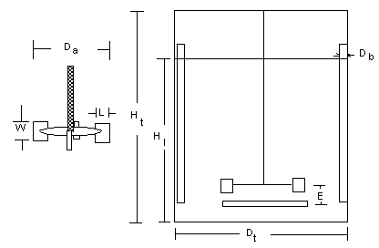
1. Design aspects of a bioreactor
A stirred tank bioreactor is approximately cylindrical in shape. It has a total volume (V_{t}) of 100,000 liters. The geometry of the reactor is defined by the following ratios:
D_{t}:H_{t}=0,5 ; D_{a}:D_{t}=0,33 ; D_{b}:D_{t} = 0,1
Is it an aerated system?
Yes, the bioreactor is aerated. The sparger positioned beneath the agitator provides the air.
The stirred tank bioreactor (STR)
b) Is this type of bioreactor advantageous for mammalian cells?
The aspect ratio of this bioreactor is 2. Bioreactors for mammalian cells have aspect ratios of 1, while microbial cells cultures in a STR have a aspect ratio of 3. In this limiting case it is still possible to culture mammalian cells, even though the aspect ratio is above 1.

Slide 4
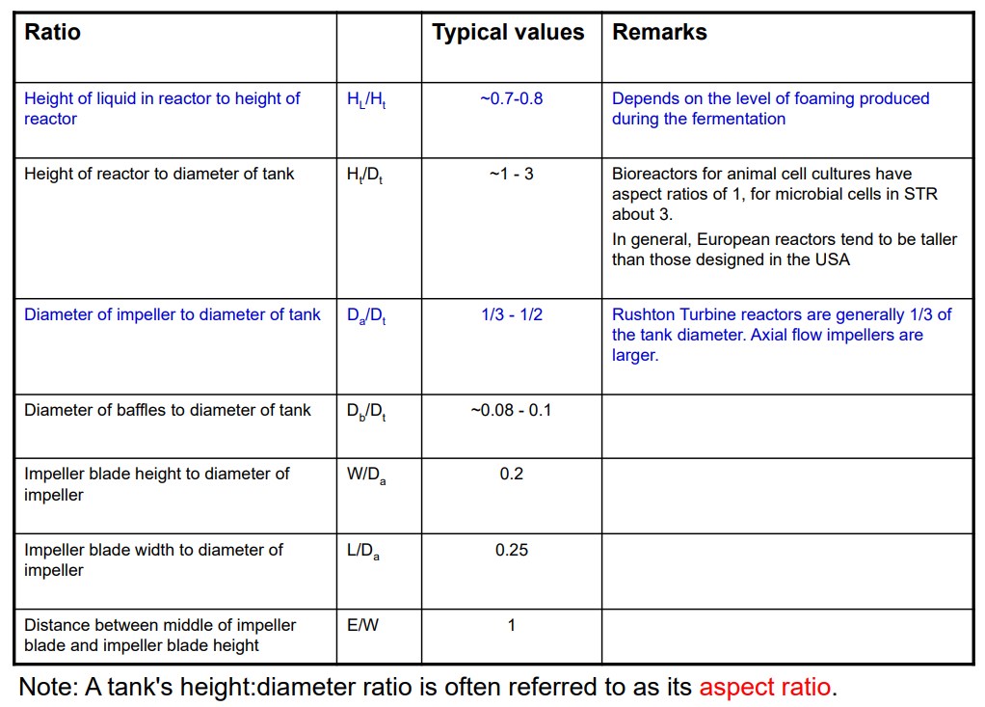
1. Design aspects of a bioreactor

Slide 5
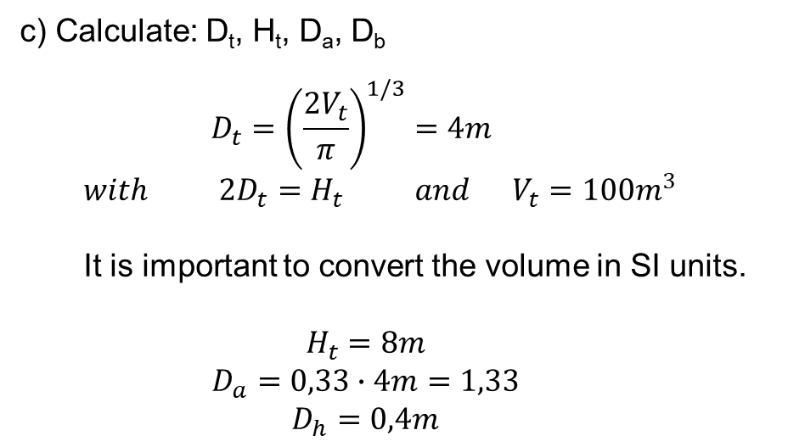
1. Design aspects of a bioreactor
A stirred tank bioreactor is approximately cylindrical in shape. It has a total volume (V_{t}) of 100,000 liters. The geometry of the reactor is defined by the following ratios:
D_{t}:H_{t}=0,5 ; D_{a}:D_{t}=0,33 ; D_{b}:D_{t} = 0,1
c) Calculate: D_{t}, H_{t}, D_{a}, D_{b}
$$D_{t}={\left(\frac{2V_{t}}{π}\right)}^{1/3}=4m$$
$$with 2D_{t}=H_{t} and V_{t}=100m^{3}$$
It is important to convert the volume in SI units.
$$H_{t}=8m$$
$$D_{a}=0,33∙4m=1,33$$
$$D_{h}=0,4m$$
The stirred tank bioreactor (STR)

Slide 6
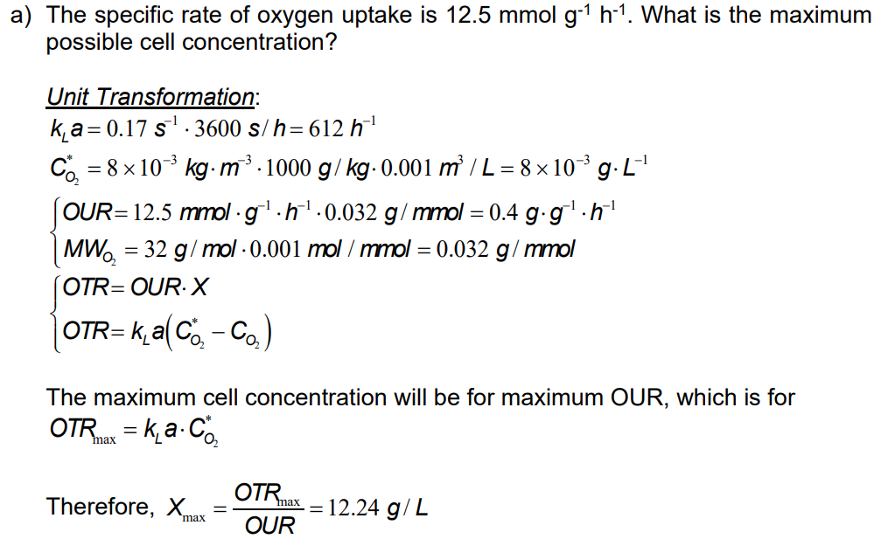
2. Cell concentration in aerobic culture
A strain of Azotobacter vinelandii is cultured in a 15m³ stirred Fermenter for alginate production. Under current operating conditions k_{L}a is 0.17 s⁻¹. Oxygen solubility in the broth is approx. 8 x 10⁻³ kg m⁻³.

Slide 7
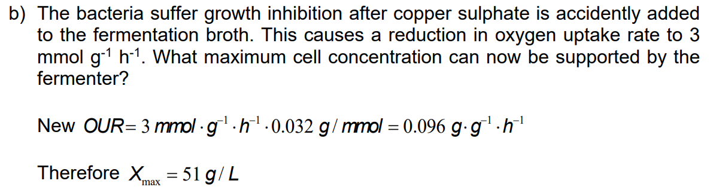

Slide 8
3. Specific oxygen uptake in E. coli culture
It is assumed, that the specific oxygen uptake rate (q_{O2}) of E. coli is 5.0 mmol g⁻¹ h⁻¹.
Which cell concentration X can be reached in a laboratory reactor with a k_{L}a of 25 h⁻¹ when C_{L} = 10 % C* and for the medium at 37 °C is C* = 0.17 mmol L⁻¹.
Working according to the exercise (2) we have

Slide 9
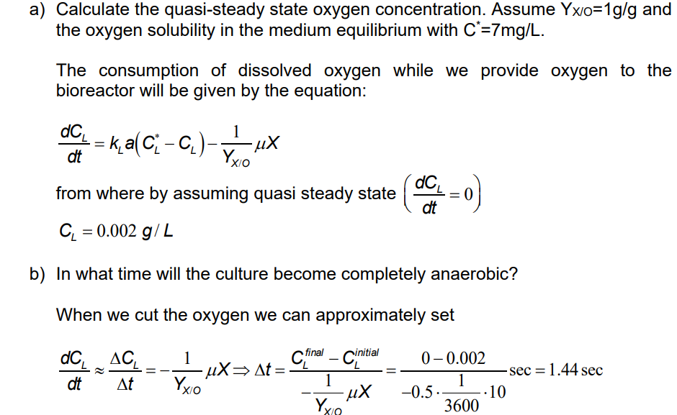
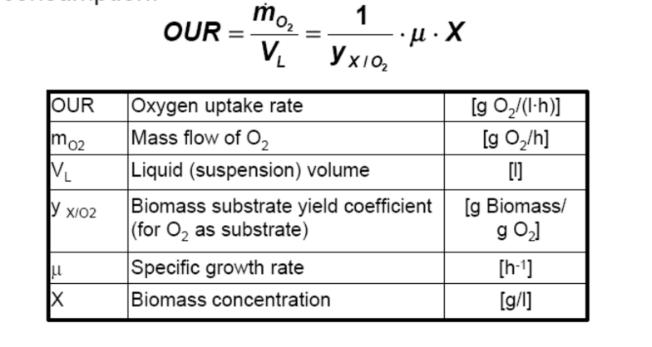
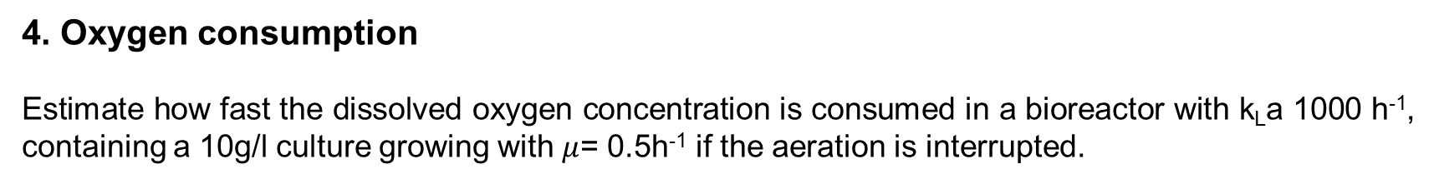
4. Oxygen consumption
Estimate how fast the dissolved oxygen concentration is consumed in a bioreactor with k_{L}a 1000 h⁻¹, containing a 10g/l culture growing with $μ$= 0.5h⁻¹ if the aeration is interrupted.

Slide 10
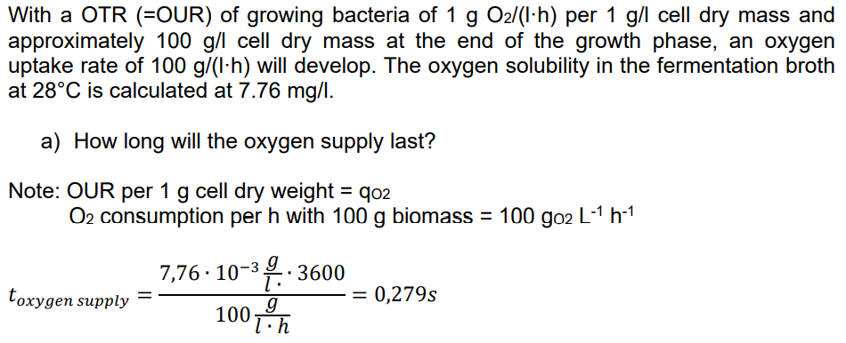
5. Oxygen storage capacity of a fermentation broth

Slide 11
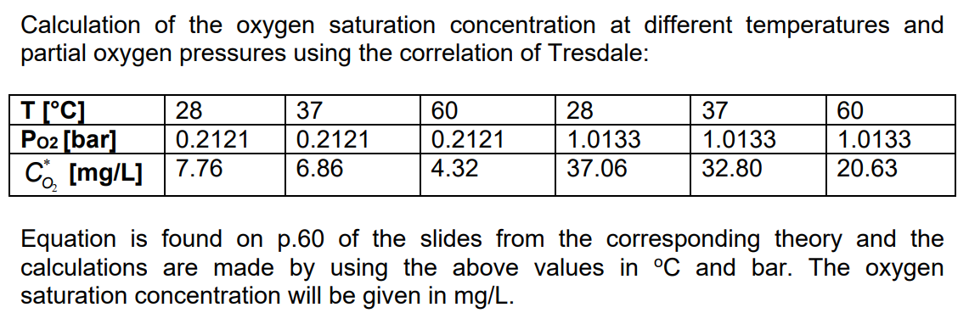
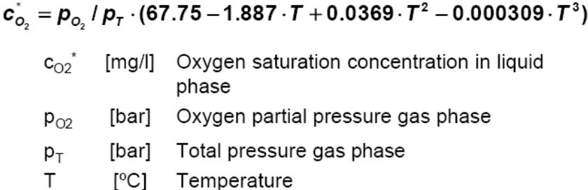
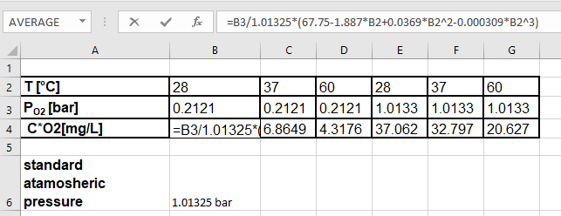
6. Calculating saturation concentration

Slide 12
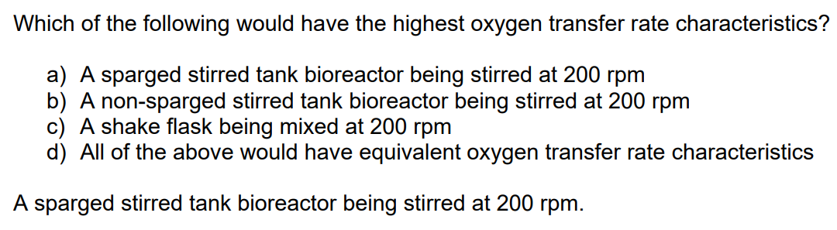
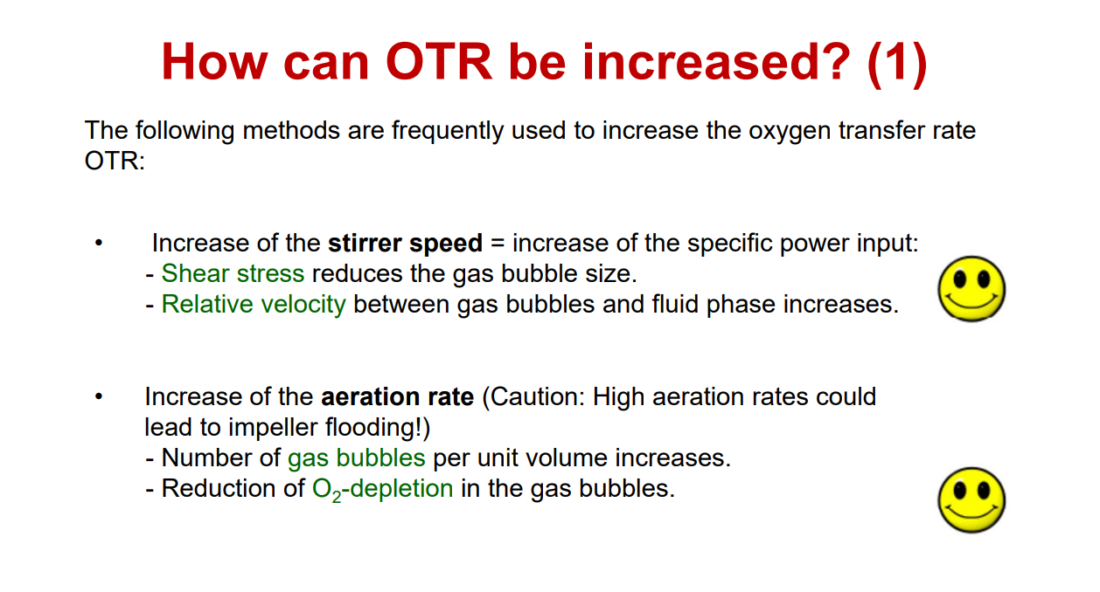
7. Oxygen transfer in a sparged stirred tank bioreactor

